Slide 1
Norm of a vector
Why Norm in Data Science?
To summarize or compress the information about a data vector
to a single number .
Example:
To find magnitude of a data point(row vector)
To find the loss in machine learning model
To compute the error in a predictive model

Slide 2
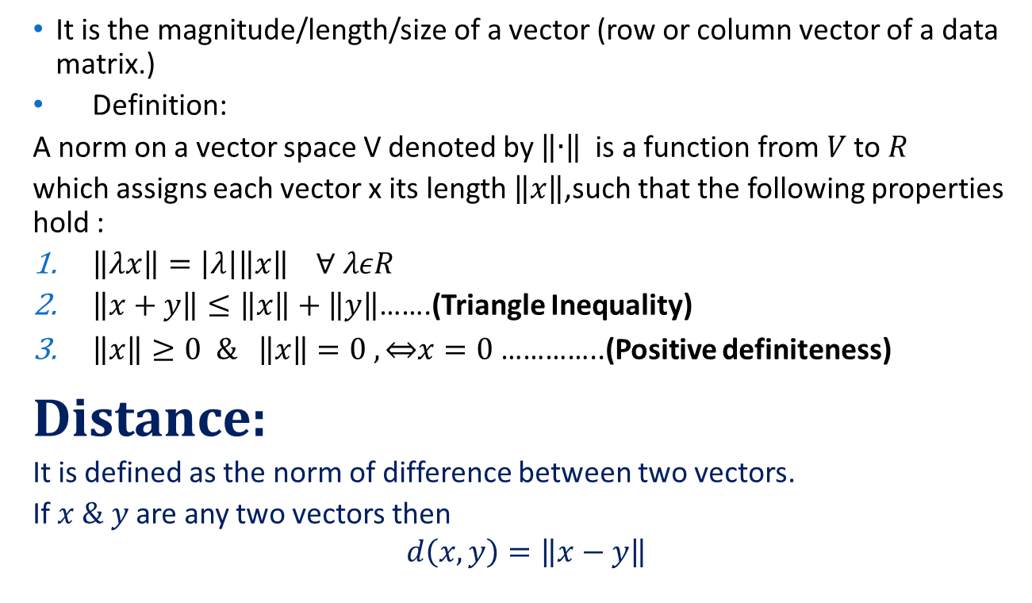
Norm:
It is the magnitude/length/size of a vector (row or column vector of a data matrix.)
Definition:
A norm on a vector space V denoted by $\left\|∙\right\|$is a function from$V$ to $R$
which assigns each vector x its length $\left\|x\right\|$,such that the following properties hold :
$\left\|λx\right\|=\left|λ\right|\left\|x\right\| ∀ λεR$
$\left\|x+y\right\|≤\left\|x\right\|+\left\|y\right\|$…….(Triangle Inequality)
$\left\|x\right\|≥0 \& \left\|x\right\|=0 , \overset{⇔}{}x=0$ …………..(Positive definiteness)
Distance:
It is defined as the norm of difference between two vectors.
If $x \& y$ are any two vectors then
$$d\left(x,y\right)=\left\|x−y\right\|$$

Slide 3
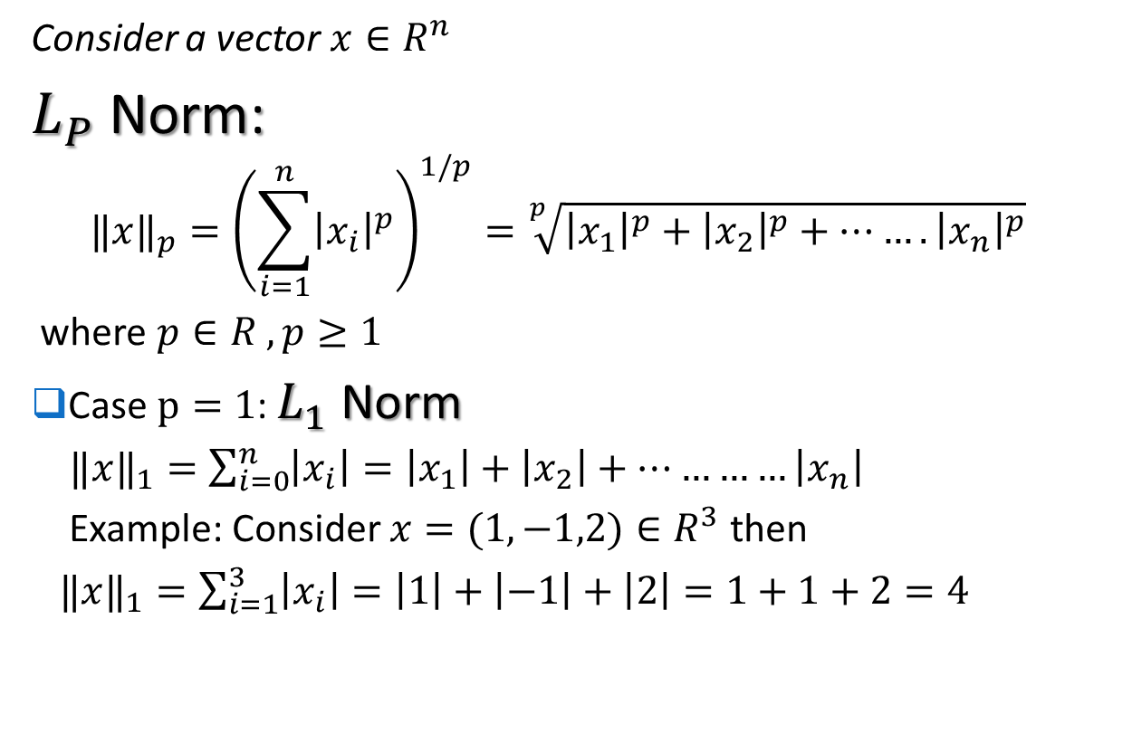
Types of Norms
Consider a vector $x∈R^{n}$
$L_{P}$ Norm:
$${‖x‖}_{p}={\left(\sum_{i=1}^{n}{{\left|x_{i}\right|}^{p}}\right)}^{1/p}=\sqrt[p]{{\left|x_{1}\right|}^{p}+{\left|x_{2}\right|}^{p}+…….{\left|x_{n}\right|}^{p}}$$
where $p∈R , p≥1$
Case $p=1$: $L_{1}$ Norm
${‖x‖}_{1}=\sum_{i=0}^{n}{\left|x_{i}\right|}=\left|x_{1}\right|+\left|x_{2}\right|+…………\left|x_{n}\right|$
Example: Consider $x=(1,−1,2)∈R^{3}$ then
${‖x‖}_{1}=\sum_{i=1}^{3}{\left|x_{i}\right|}=\left|1\right|+\left|−1\right|+\left|2\right|=1+1+2=4$

Slide 4
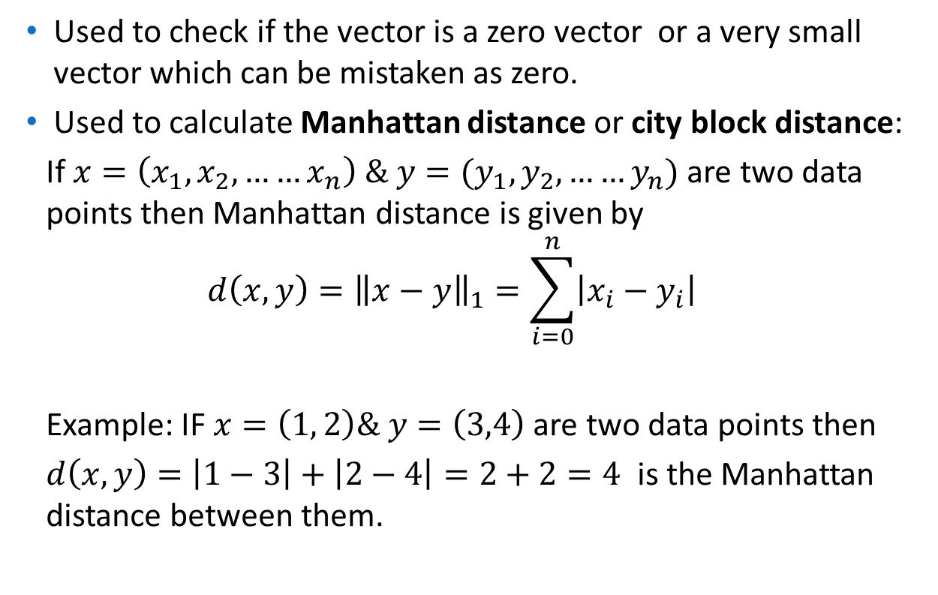

Uses of $L_{1}$ Norm
Used to check if the vector is a zero vector or a very small vector which can be mistaken as zero.
Used to calculate Manhattan distance or city block distance:
If $x=\left(x_{1}, x_{2},……x_{n}\right) \& y=(y_{1}, y_{2},……y_{n})$ are two data points then Manhattan distance is given by
$$d\left(x,y\right)={\left\|x−y\right\|}_{1}=\sum_{i=0}^{n}{\left|x_{i}−y_{i}\right|}$$
Example: IF $x=\left(1, 2\right)\& y=\left(3,4\right)$ are two data points then
$d\left(x,y\right)=\left|1−3\right|+\left|2−4\right|=2+2=4$ is the Manhattan distance between them.

Slide 5
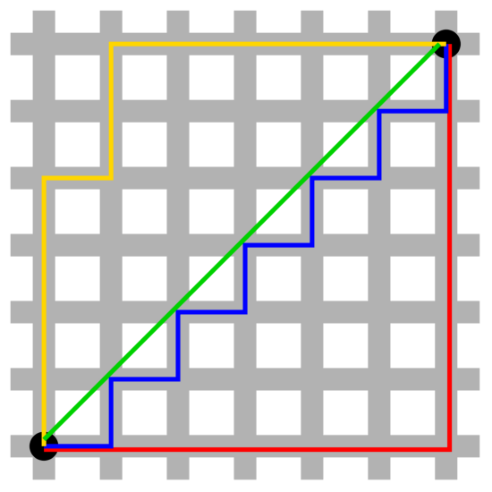

Geometric view:
(3,4)
(1,2)
$$L_{1} Norm$$
Source: Wikipedia

Slide 6
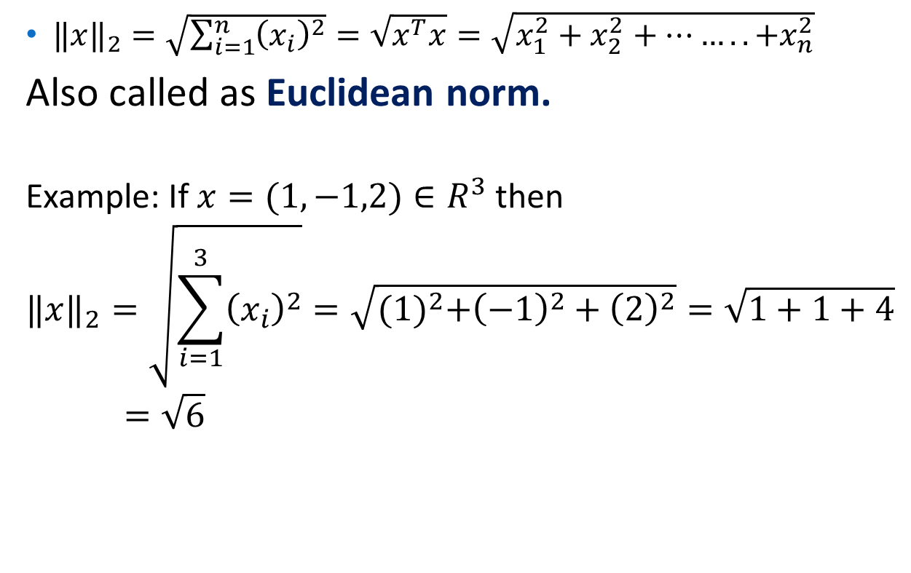

Case $p=2:L_{2} \text{Norm}$
${‖x‖}_{2}=\sqrt{\sum_{i=1}^{n}{{\left(x_{i}\right)}^{2}}}=\sqrt{x^{T}x}=\sqrt{x_{1}^{2}+x_{2}^{2}+……..+x_{n}^{2}}$
Also called as Euclidean norm.
Example: If $x=(1,−1,2)∈R^{3}$ then
$${‖x‖}_{2}=\sqrt{\sum_{i=1}^{3}{{\left(x_{i}\right)}^{2}}}=\sqrt{{(1)}^{2}+{\left(−1\right)}^{2}+{\left(2\right)}^{2}}=\sqrt{1+1+4}=\sqrt{6}$$

Slide 7
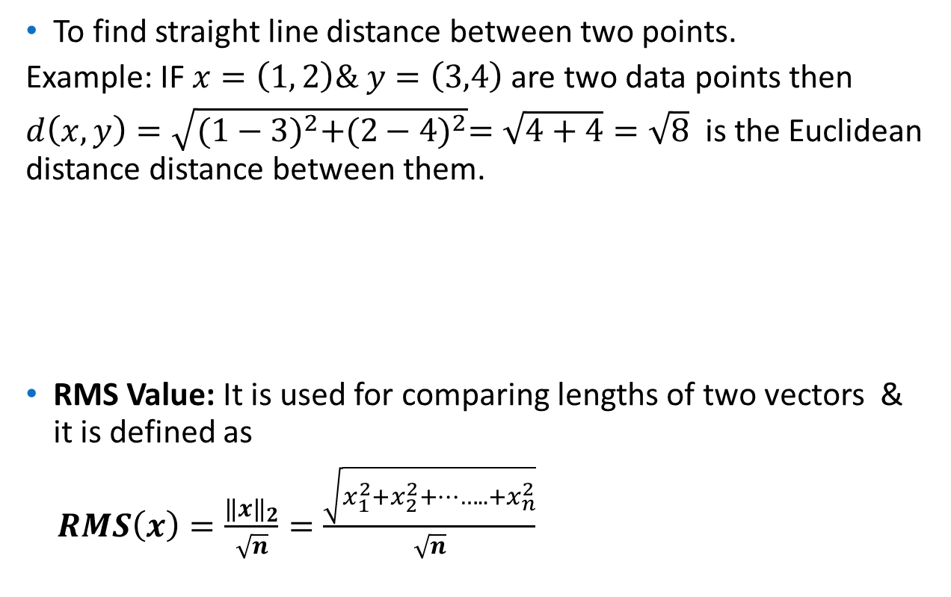

Uses of $L_{2}$ Norm
To find straight line distance between two points.
Example: IF $x=\left(1, 2\right)\& y=\left(3,4\right)$ are two data points then
$d\left(x,y\right)=\sqrt{{(1−3)}^{2}+{(2−4)}^{2}}=\sqrt{4+4}=\sqrt{8}$ is the Euclidean distance distance between them.
RMS Value: It is used for comparing lengths of two vectors & it is defined as
$RMS\left(x\right)=\frac{{\left\|x\right\|}_{2}}{\sqrt{n}}=\frac{\sqrt{x_{1}^{2}+x_{2}^{2}+……..+x_{n}^{2}}}{\sqrt{n}}$
(3,4)
(1,2)

Slide 8



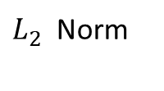
$L_{1 }vs L_{2}$ Norm
(3,4)
$L_{1 }$Norm
$L_{2}$ Norm
(1,2)
As can be seen from the figure $L_{2 }$Norm $≤$ $L_{2}$ Norm
$L_{1}$ norm is more robust(to outliers) than $L_{2}$ norm (as they are squared in $L_{2}$ norm)
$L_{2}$ norm produces stable solutions than $L_{1}$ norm.(since $L_{1}$ contains absolute values & is not differentiable)

Slide 9
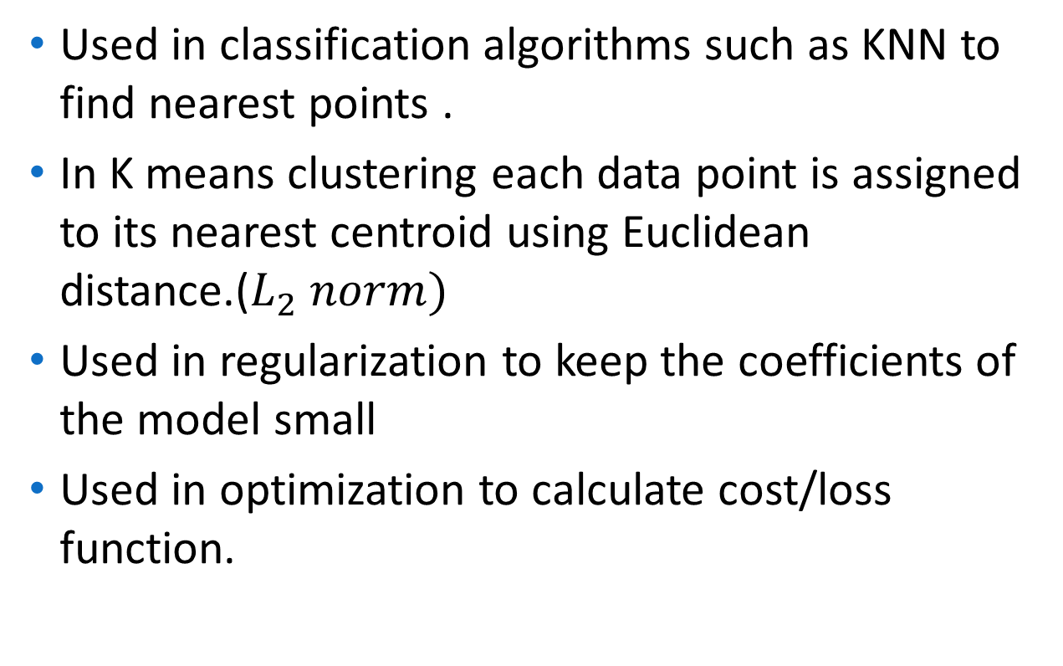
Applications of norms in data science:
Used in classification algorithms such as KNN to find nearest points .
In K means clustering each data point is assigned to its nearest centroid using Euclidean distance.($L_{2} norm)$
Used in regularization to keep the coefficients of the model small
Used in optimization to calculate cost/loss function.

Slide 10
Optimization
In real world problems, optimization is a process of making something as good or effective as possible. This process involves choosing inputs that give the best or desired output.
Example :
Choosing optimum location of warehouse to reduce shipment time
Designing a bridge that can carry maximum possible/desired load
Selecting stocks that will create maximum returns

Slide 11
Optimization
In mathematics, optimization is a process of optimizing i.e. maximizing or minimizing a function of one or more variables on a given domain. Here the function to be optimized is called an objective function which is a quantitative measure of performance.
For example: to maximize profits, minimize time, minimize
costs, maximize sales are some optimization problems in day
to day life
Cost function or loss function are some frequently used terms for objective function used in machine learning. The input parameters to the cost function are called decision/design variables.

Slide 12
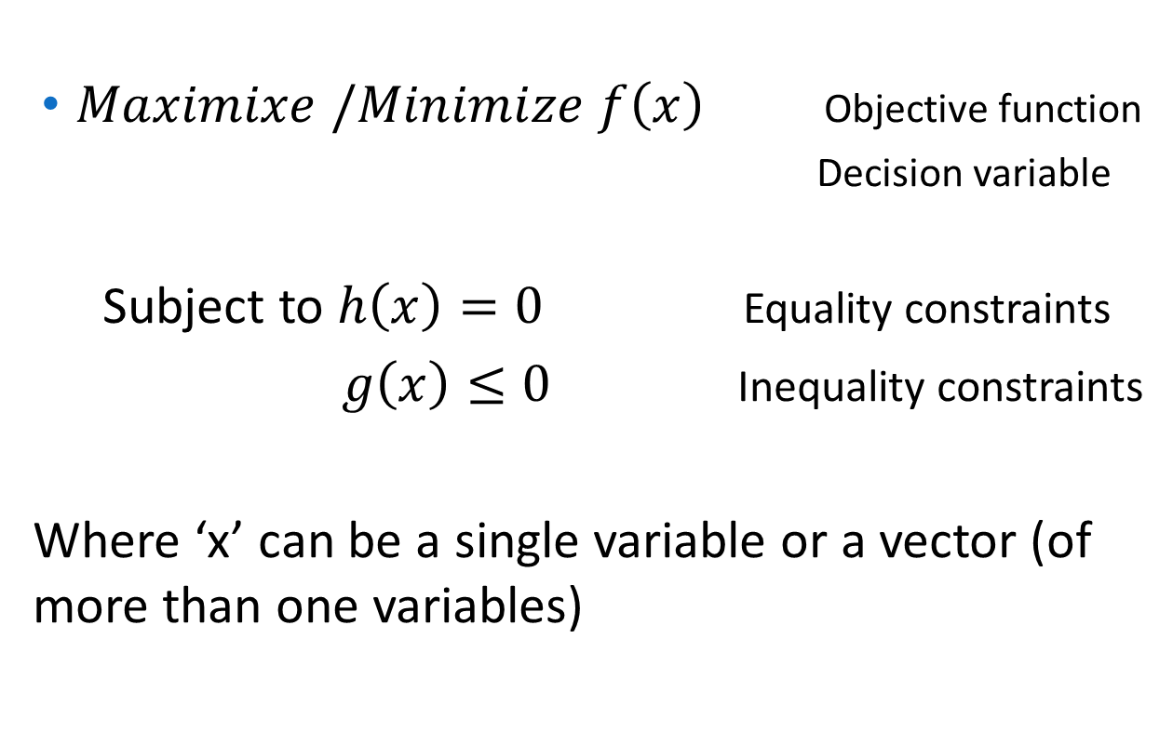
Mathematical formulation of optimization problem:
$Maximixe /Minimize$ $f\left(x\right)$ Objective function
Decision variable
Subject to $h\left(x\right)=0$ Equality constraints
$g\left(x\right)≤0$ Inequality constraints
Where ‘x’ can be a single variable or a vector (of more than one variables)

Slide 13
Types of Optimization:
optimization problems can be classified into various categories based on nature of objective function, decision variables and constraints , physical structure of the problem etc.
Few important classifications are:
Constrained Vs. unconstrained optimization: If there are one or more constraints on decision variables then it is constrained optimization problem and in case there are no constraints then it is unconstrained optimization.
Linear Vs. Non-linear Optimization : If the objective function and all the constraints are linear functions of decision variables then the optimization problem is called linear programming problem(LPP) otherwise it is called non linear programming (NLP) problem.

Slide 14
Types of Optimization:
Discrete Vs. Continuous optimization:
If some or all the decision variables are restricted to take only integer values then the optimization problem is called integer programming problem or discrete optimization Otherwise it is called continuous optimization where the decision variables take continuous set of values.
Deterministic Vs. Stochastic Optimization:
In deterministic optimization, it is assumed that the data for the given problem are known accurately. However, for many actual problems, the data cannot be known accurately for a variety of reasons. The first reason is due to simple measurement error. The second and more fundamental reason is that some data represent information about the future (e. g., product demand or price for a future time period) and simply cannot be known with certainty. In stochastic optimization, the uncertainty is incorporated into the model.

Slide 15
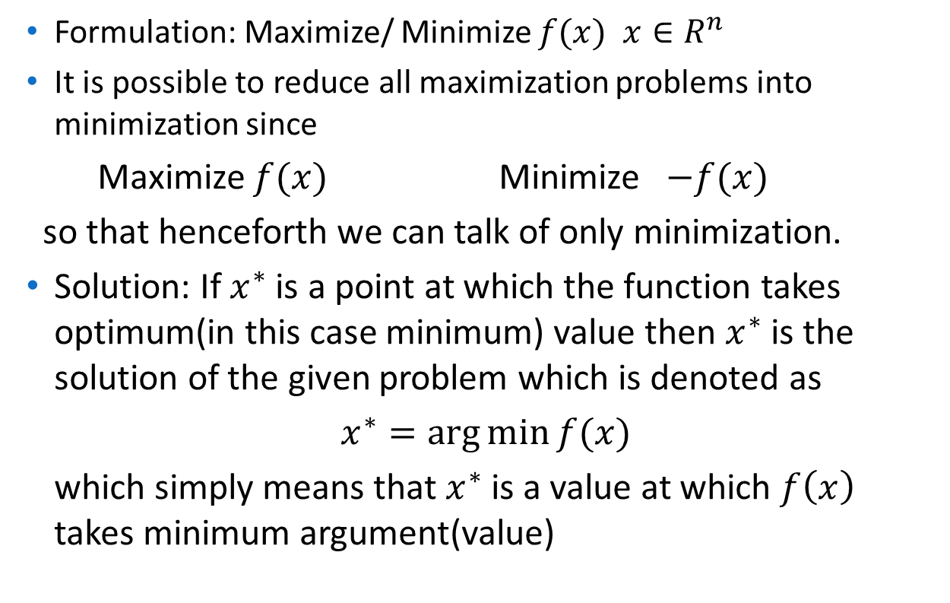
Unconstrained Optimization
Formulation: Maximize/ Minimize $f(x)$ $x∈R^{n}$
It is possible to reduce all maximization problems into minimization since
Maximize $f(x)$ Minimize $−f(x)$
so that henceforth we can talk of only minimization.
Solution: If $x^{∗}$ is a point at which the function takes optimum(in this case minimum) value then $x^{∗}$ is the solution of the given problem which is denoted as
$x^{∗}=\arg{\min{f(x)}}$
which simply means that $x^{∗}$ is a value at which $f\left(x\right)$ takes minimum argument(value)

Slide 16
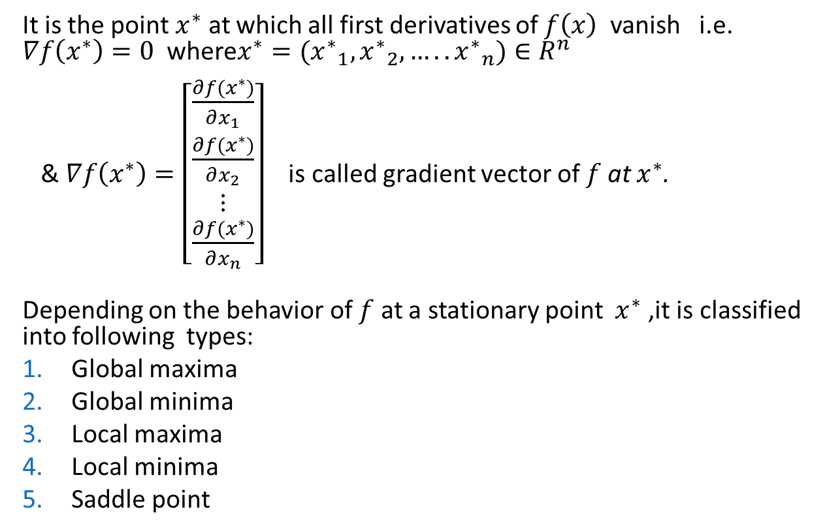
Stationary point
It is the point $x^{∗}$ at which all first derivatives of $f\left(x\right)$ vanish i.e. $∇f\left(x^{∗}\right)=0$ where$x^{∗}=({x^{∗}}_{1},{x^{∗}}_{2},…..{x^{∗}}_{n})∈R^{n}$
& $∇f\left(x^{∗}\right)=\left[\begin{matrix}\frac{∂f(x^{∗})}{∂x_{1}} \\ \frac{∂f(x^{∗})}{∂x_{2}} \\ \begin{matrix}⋮ \\ \frac{∂f(x^{∗})}{∂x_{n}}\end{matrix}\end{matrix}\right]$ is called gradient vector of $f$at $x^{∗}$.
Depending on the behavior of $f$ at a stationary point $x^{∗}$ ,it is classified into following types:
Global maxima
Global minima
Local maxima
Local minima
Saddle point

Slide 17
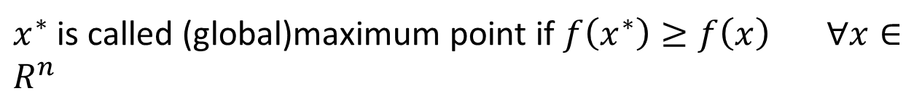


Global Maximum or maximum point:
${f(x}^{∗}$)
$$x^{∗}$$
$x^{∗}$ is called (global)maximum point if $f\left(x^{∗}\right)≥f\left(x\right) ∀x∈R^{n}$

Slide 18


Global Minimum or minimum point:
$x^{∗}$ is called (global)minimum point if $f\left(x^{∗}\right)≤f\left(x\right) ∀x∈R^{n}$
$$f(x_{∗})$$

Slide 19
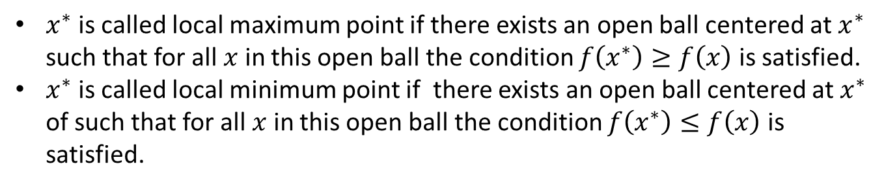
Relative Maximum & minimum point:
$x^{∗}$is called local maximum point if there exists an open ball centered at $x^{∗}$ such that for all $x$ in this open ball the condition $f\left(x^{∗}\right)≥f\left(x\right)$ is satisfied.
$x^{∗}$is called local minimum point if there exists an open ball centered at $x^{∗}$ of such that for all $x$ in this open ball the condition $f\left(x^{∗}\right)≤f\left(x\right)$ is satisfied.

Slide 20

Saddle point:
Saddle point
If $x^{∗}$ is neither (global/local)maximum nor (global/local)minimum is called a saddle point.

Slide 21
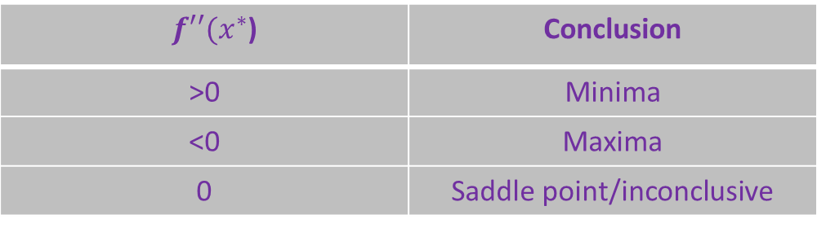
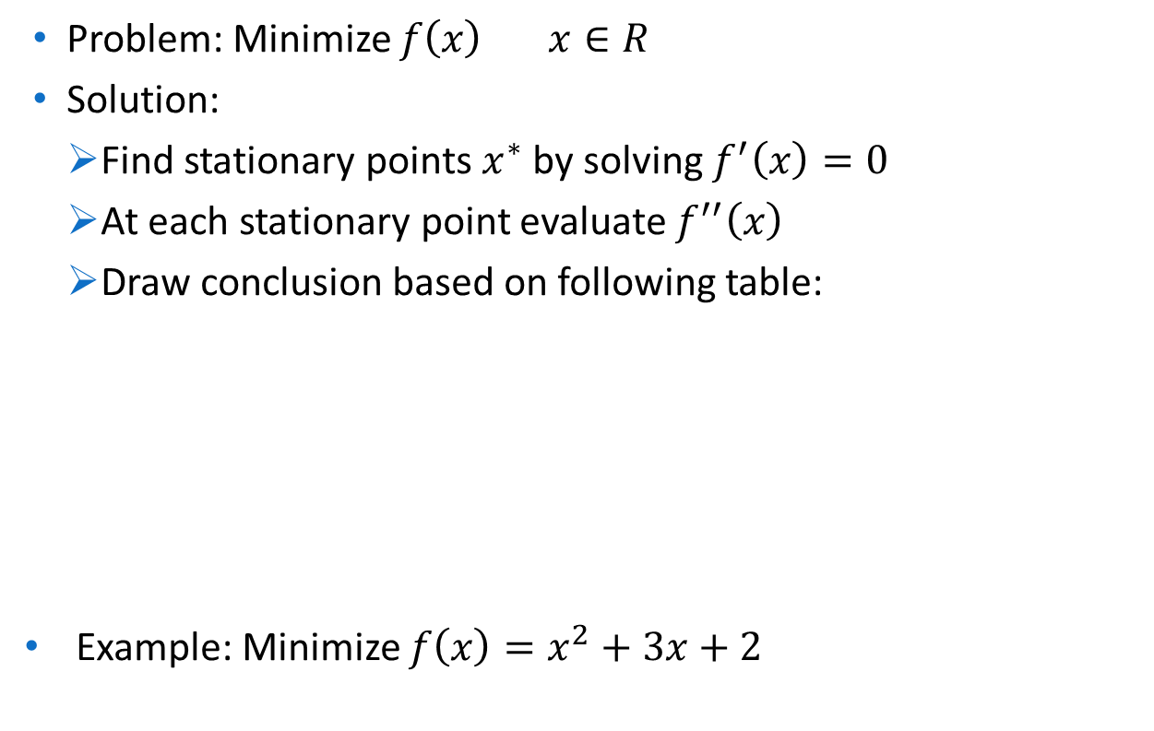
Optimization of function of one variable
Problem: Minimize $f\left(x\right) x∈R$
Solution:
Find stationary points $x^{∗}$ by solving $f^{′}\left(x\right)=0$
At each stationary point evaluate $f^{′′}\left(x\right)$
Draw conclusion based on following table:
Example: Minimize $f\left(x\right)=x^{2}+3x+2$
$f′′(x^{∗}$) | Conclusion
>0 | Minima
<0 | Maxima
0 | Saddle point/inconclusive

Slide 22
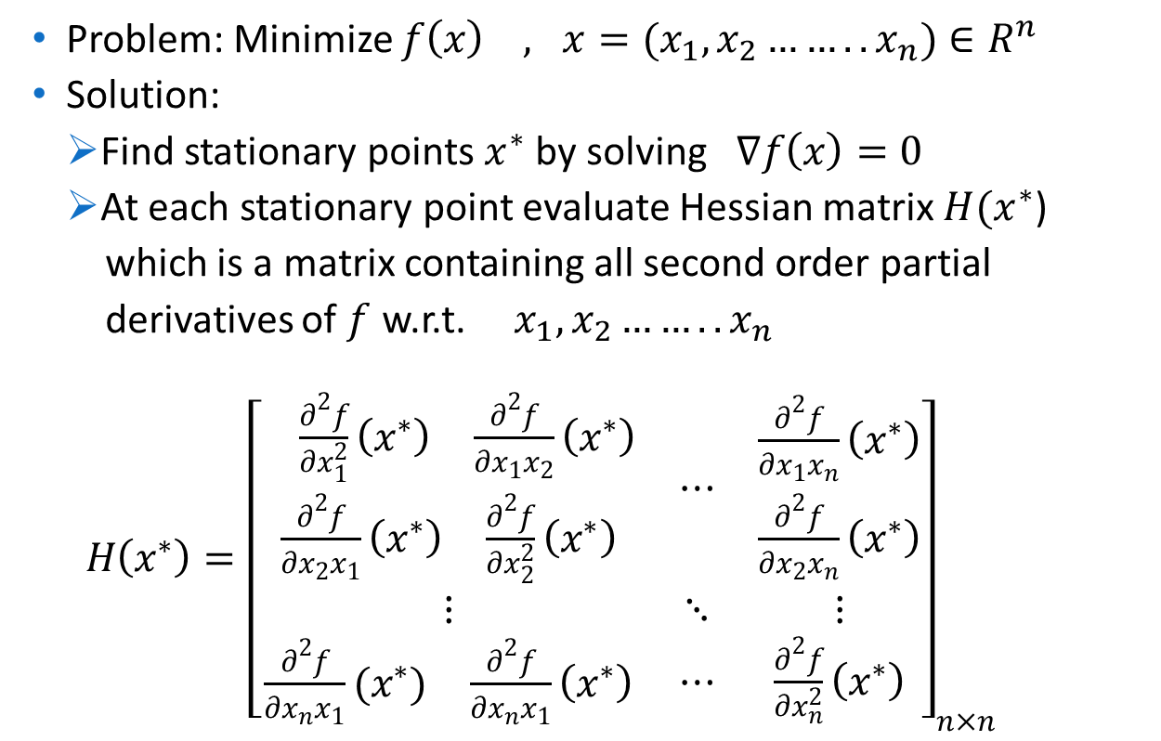
Optimization of function of two variables
Problem: Minimize $f\left(x\right) , x=(x_{1},x_{2}……..x_{n})∈R^{n}$
Solution:
Find stationary points $x^{∗}$ by solving$∇f\left(x\right)=0$
At each stationary point evaluate Hessian matrix $H(x^{∗}$)
which is a matrix containing all second order partial
derivatives of $f$ w.r.t. $x_{1},x_{2}……..x_{n}$
$H\left(x^{∗}\right)={\left[\begin{matrix}\begin{matrix}\begin{matrix} \frac{∂^{2}f}{∂x_{1}^{2}}\left(x^{∗}\right) & \frac{∂^{2}f}{∂x_{1}x_{2}}\left(x^{∗}\right)\end{matrix} \\ \begin{matrix}\frac{∂^{2}f}{∂x_{2}x_{1}}\left(x^{∗}\right) & \frac{∂^{2}f}{∂x_{2}^{2}}\left(x^{∗}\right)\end{matrix}\end{matrix} & ⋯ & \begin{matrix}\frac{∂^{2}f}{∂x_{1}x_{n}}\left(x^{∗}\right) \\ \frac{∂^{2}f}{∂x_{2}x_{n}}\left(x^{∗}\right)\end{matrix} \\ ⋮ & ⋱ & ⋮ \\ \begin{matrix}\frac{∂^{2}f}{∂x_{n}x_{1}}(x^{∗}) & \frac{∂^{2}f}{∂x_{n}x_{1}}\left(x^{∗}\right)\end{matrix} & ⋯ & \frac{∂^{2}f}{∂x_{n}^{2}}\left(x^{∗}\right)\end{matrix}\right]}_{n×n}$

Slide 23
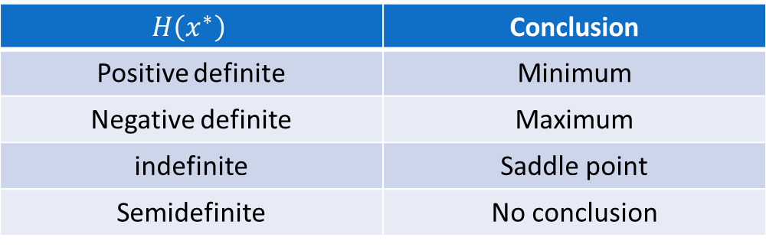
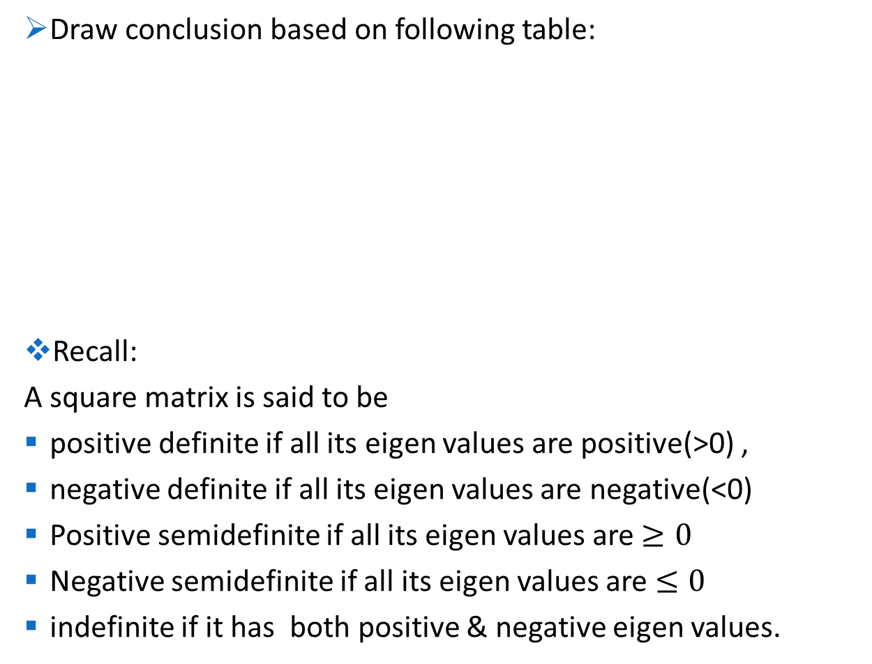
Draw conclusion based on following table:
Recall:
A square matrix is said to be
positive definite if all its eigen values are positive(>0) ,
negative definite if all its eigen values are negative(<0)
Positive semidefinite if all its eigen values are $≥0$
Negative semidefinite if all its eigen values are $≤0$
indefinite if it has both positive & negative eigen values.
$$H\left(x^{∗}\right)$$ | Conclusion
Positive definite | Minimum
Negative definite | Maximum
indefinite | Saddle point
Semidefinite | No conclusion

Slide 24
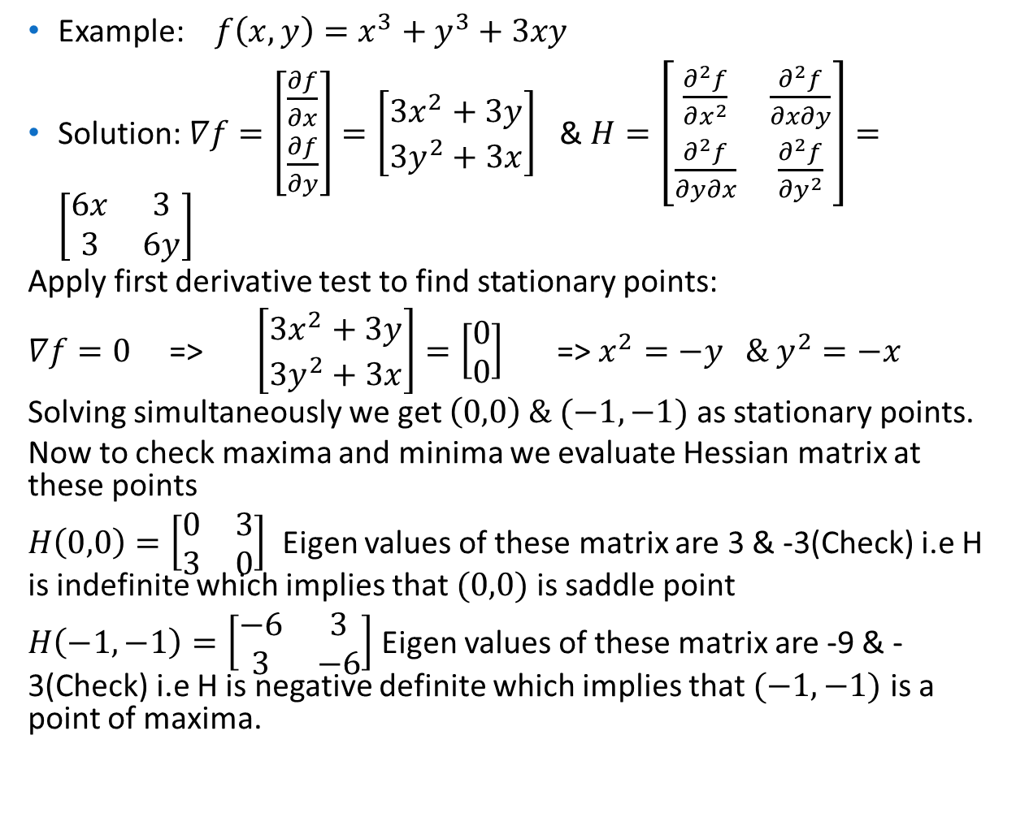
Example: $f\left(x,y\right)=x^{3}+y^{3}+3xy$
Solution: $∇f=\left[\begin{matrix}\frac{∂f}{∂x} \\ \frac{∂f}{∂y}\end{matrix}\right]=\left[\begin{matrix}3x^{2}+3y \\ 3y^{2}+3x\end{matrix}\right]$ & $H=\left[\begin{matrix}\frac{∂^{2}f}{∂x^{2}} & \frac{∂^{2}f}{∂x∂y} \\ \frac{∂^{2}f}{∂y∂x} & \frac{∂^{2}f}{∂y^{2}}\end{matrix}\right]=\left[\begin{matrix}6x & 3 \\ 3 & 6y\end{matrix}\right]$
Apply first derivative test to find stationary points:
$∇f=0$ => $\left[\begin{matrix}3x^{2}+3y \\ 3y^{2}+3x\end{matrix}\right]=\left[\begin{matrix}0 \\ 0\end{matrix}\right]$ => $x^{2}=−y \& y^{2}=−x$
Solving simultaneously we get $\left(0,0\right) \& (−1,−1)$ as stationary points.
Now to check maxima and minima we evaluate Hessian matrix at these points
$H\left(0,0\right)=\left[\begin{matrix}0 & 3 \\ 3 & 0\end{matrix}\right]$ Eigen values of these matrix are 3 & -3(Check) i.e H is indefinite which implies that $(0,0)$ is saddle point
$H\left(−1,−1\right)=\left[\begin{matrix}−6 & 3 \\ 3 & −6\end{matrix}\right]$ Eigen values of these matrix are -9 & -3(Check) i.e H is negative definite which implies that $(−1,−1)$ is a point of maxima.

Slide 25
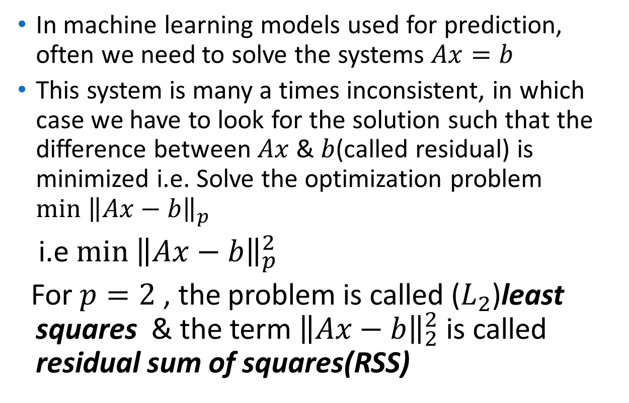
Application: Least squares
In machine learning models used for prediction, often we need to solve the systems $Ax=b$
This system is many a times inconsistent, in which case we have to look for the solution such that the difference between $Ax$ & $b$(called residual) is minimized i.e. Solve the optimization problem $\min{{\left\|Ax−b\right\|}_{p}}$
i.e $\min{{\left\|Ax−b\right\|}_{p}^{2}}$
For $p=2$ , the problem is called ($L_{2}$)least squares & the term ${\left\|Ax−b\right\|}_{2}^{2}$ is called residual sum of squares(RSS)

Slide 26
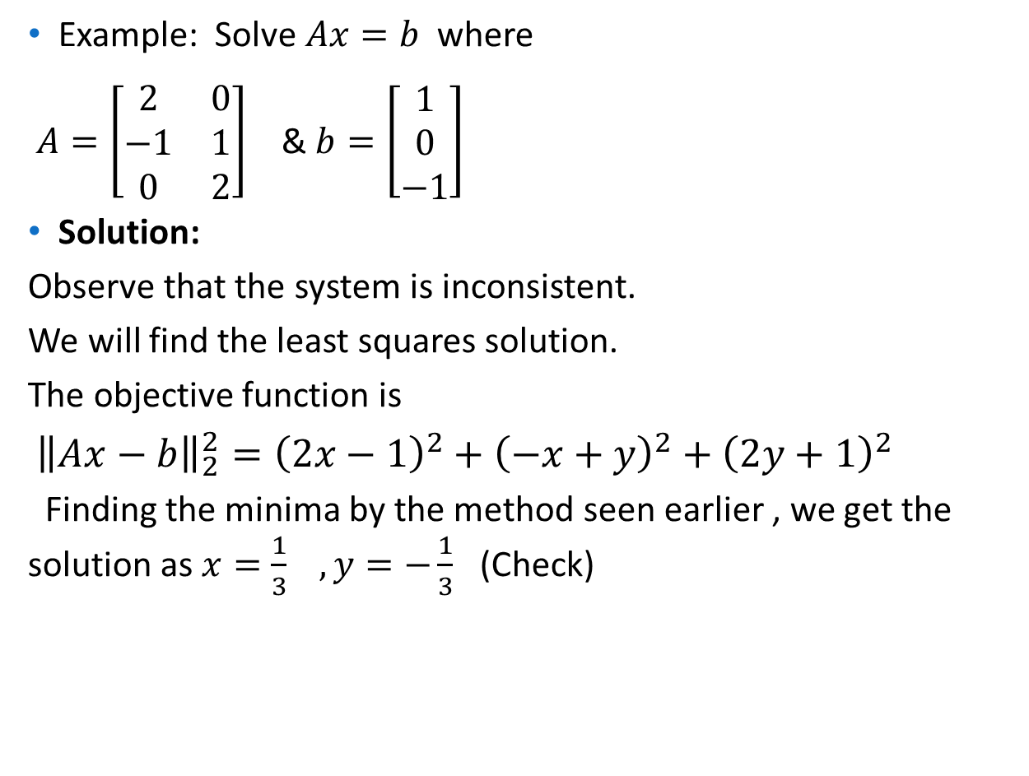
Example: Solve $Ax=b$ where
$A=\left[\begin{matrix}2 & 0 \\ −1 & 1 \\ 0 & 2\end{matrix}\right]$ & $b=\left[\begin{matrix}1 \\ 0 \\ −1\end{matrix}\right]$
Solution:
Observe that the system is inconsistent.
We will find the least squares solution.
The objective function is
${\left\|Ax−b\right\|}_{2}^{2}={\left(2x−1\right)}^{2}+{\left(−x+y\right)}^{2}+{\left(2y+1\right)}^{2}$
Finding the minima by the method seen earlier , we get the solution as $x=\frac{1}{3} , y=−\frac{1}{3}$ (Check)

Slide 27
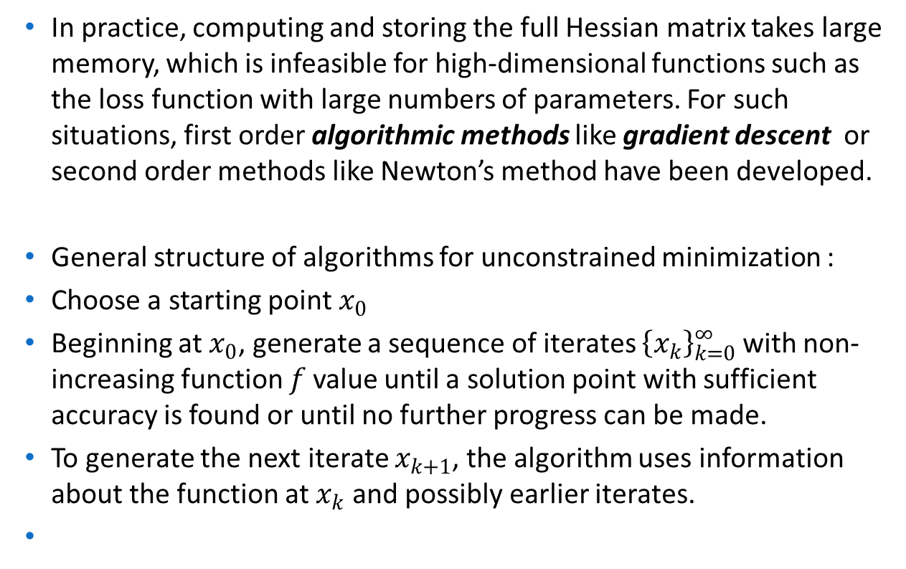
Algorithmic approach:
In practice, computing and storing the full Hessian matrix takes large memory, which is infeasible for high-dimensional functions such as the loss function with large numbers of parameters. For such situations, first order algorithmic methods like gradient descent or second order methods like Newton’s method have been developed.
General structure of algorithms for unconstrained minimization :
Choose a starting point $x_{0}$
Beginning at $x_{0}$, generate a sequence of iterates ${\left\{x_{k}\right\}}_{k=0}^{∞}$ with non-increasing function $f$ value until a solution point with sufficient accuracy is found or until no further progress can be made.
To generate the next iterate $x_{k+1}$, the algorithm uses information about the function at $x_{k}$ and possibly earlier iterates.

Slide 28
Gradient Descent:
Algorithmic method for finding a local minimum of a differentiable function.
The algorithm is initiated by choosing random values to the parameters
Improve the parameters gradually by taking steps proportional to the negative of the gradient (or approximate gradient) of the cost function at the current point.
Continue the process until the algorithm converges to a minimum i.e until the difference between the successive iterates becomes stable or reaches a threshold
Note: If we instead take steps proportional to the positive of the gradient, we approach a local maximum of that function; the procedure is then known as gradient ascent.

Slide 29
Analogy:
To get an idea of how Gradient Descent works, let us take an example. Suppose you are at the top of a mountain and want to reach the base camp which is all the way down at the lowest point of the mountain. Also, due to the bad weather, the visibility is really low and you cannot see the path at all. How would you reach the base camp?
One of the ways is to use your feet to know where the land tends to descend. This will give an idea in what direction, the steep is low and you should take your first step. If you follow the descending path until you encounter a plain area or an ascending path, it is very likely you would reach the base camp.

Slide 30
Limitation:
If there is a slight rise in the ground when you are going downhill you would immediately stop assuming that you reached the base camp (global minima), but in reality, you are still stuck at the mountain at a local minima.
In other words , gradient descent does not guarantee finding global mimina(maxima) of the function
However most of the objective functions used in machine learning such as cost function are convex functions which ensure that the local minimum is also a global minimum.

Slide 31
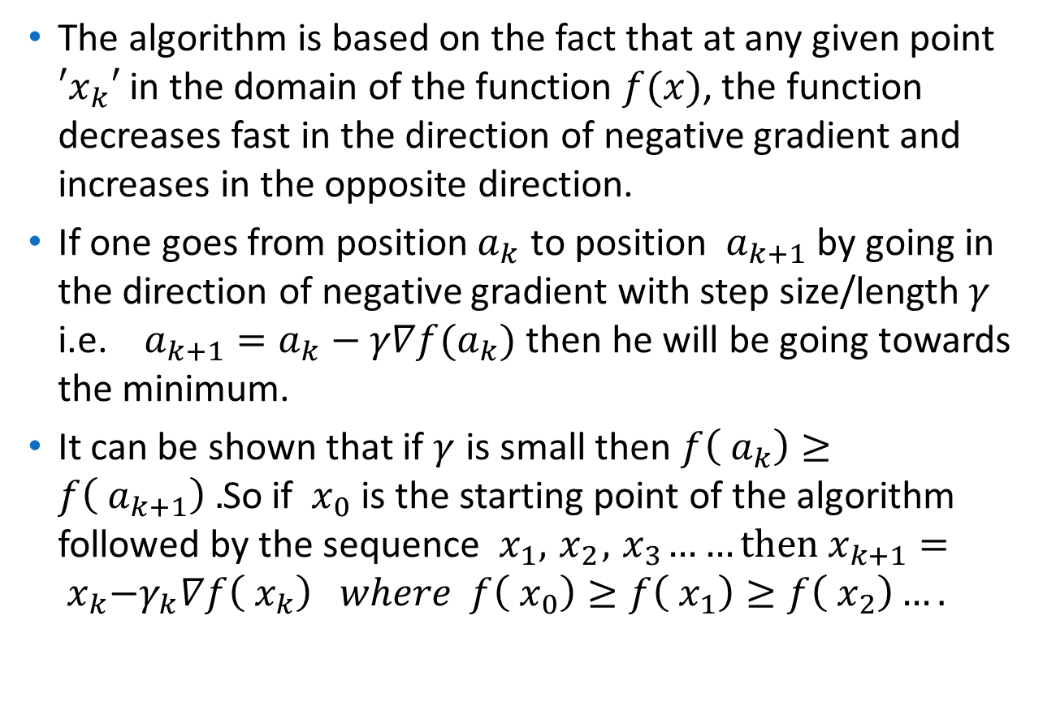
Mathematical formulation of the idea:
The algorithm is based on the fact that at any given point $′x_{k}′$ in the domain of the function $f(x)$, the function decreases fast in the direction of negative gradient and increases in the opposite direction.
If one goes from position${ a}_{k}$ to position ${ a}_{k+1}$ by going in the direction of negative gradient with step size/length $γ$ i.e. $a_{k+1}=a_{k}−γ∇f(a_{k})$ then he will be going towards the minimum.
It can be shown that if $γ$ is small then $f\left({ a}_{k}\right)≥f\left({ a}_{k+1}\right) .$So if ${ x}_{0}$ is the starting point of the algorithm followed by the sequence ${ x}_{1},{ x}_{2},{ x}_{3}……then$ $x_{k+1}={ x}_{k}−γ_{k}∇f\left({ x}_{k}\right) where f\left({ x}_{0}\right)≥f\left({ x}_{1}\right)≥f\left({ x}_{2}\right)….$

Slide 32
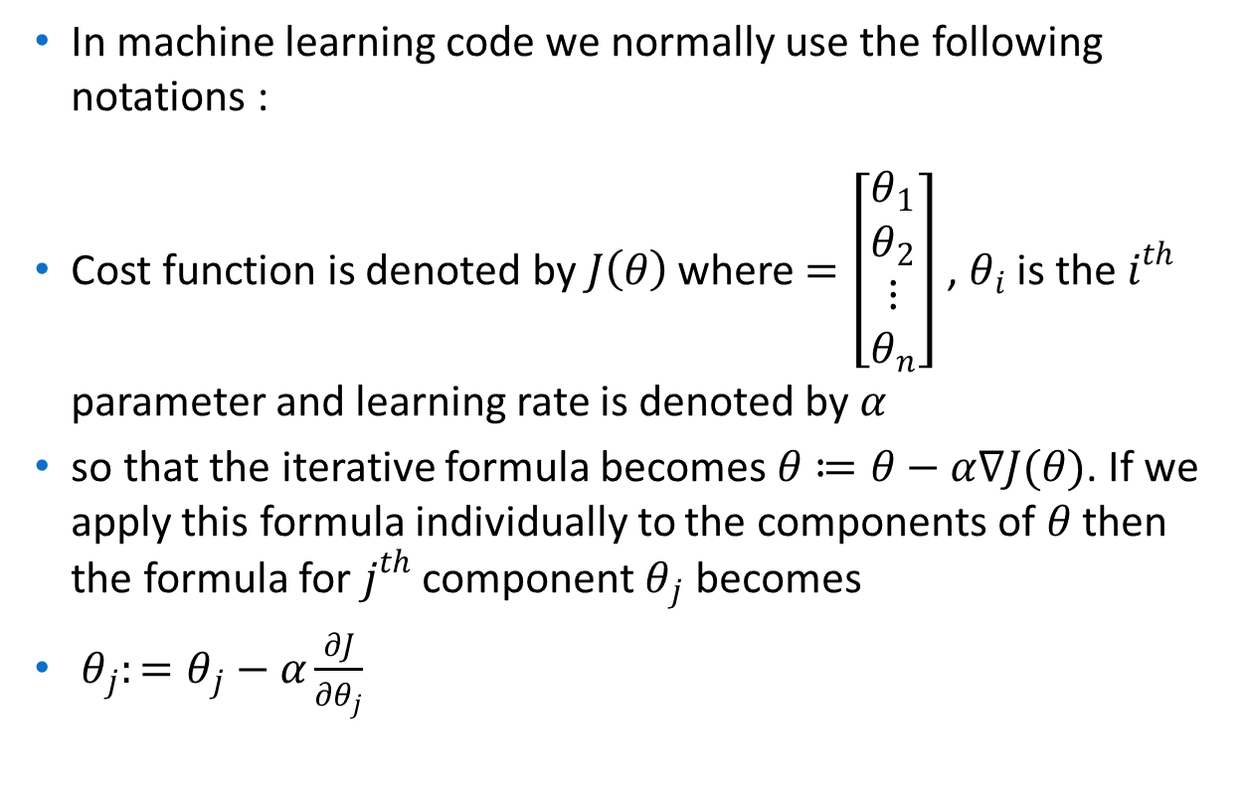
Algorithm in machine learning
In machine learning code we normally use the following notations :
Cost function is denoted by $J\left(θ\right)$ where $=\left[\begin{matrix}θ_{1} \\ θ_{2} \\ \begin{matrix}⋮ \\ θ_{n}\end{matrix}\end{matrix}\right]$ , $θ_{i}$ is the $i^{th}$ parameter and learning rate is denoted by $α$
so that the iterative formula becomes $θ≔θ−α∇J(θ)$. If we apply this formula individually to the components of $θ$ then the formula for $j^{th}$ component $θ_{j}$ becomes
$θ_{j}:=θ_{j}−α\frac{∂J}{∂θ_{j}}$

Slide 33
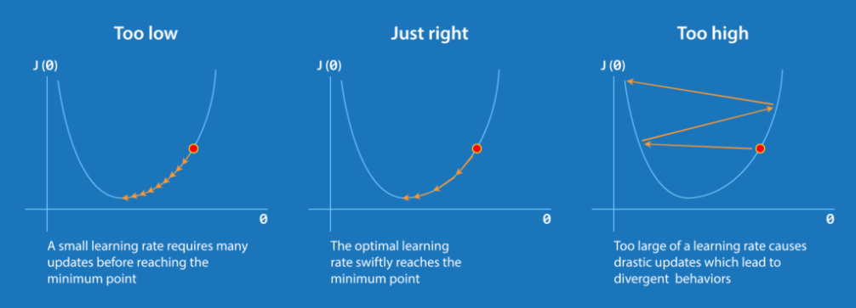
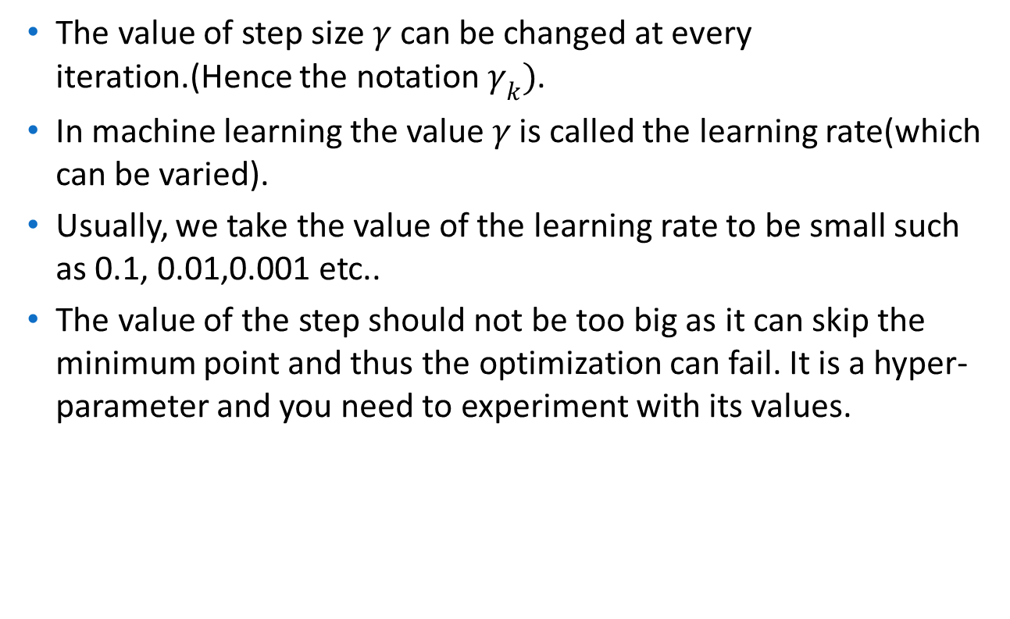
Note on step size:
The value of step size $γ$ can be changed at every iteration.(Hence the notation $γ_{k})$.
In machine learning the value $γ$ is called the learning rate(which can be varied).
Usually, we take the value of the learning rate to be small such as 0.1, 0.01,0.001 etc..
The value of the step should not be too big as it can skip the minimum point and thus the optimization can fail. It is a hyper-parameter and you need to experiment with its values.

Slide 34
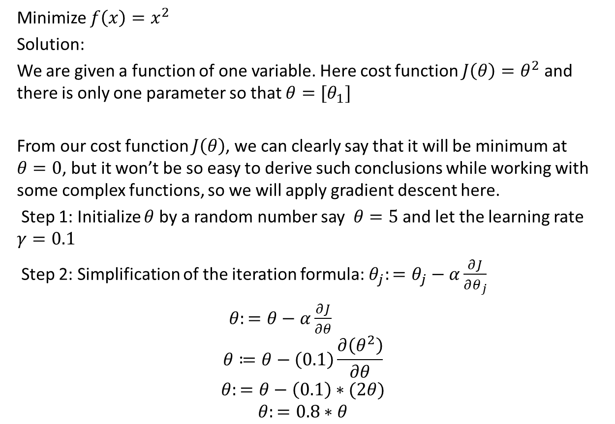
Example:Single variable case
Minimize $f\left(x\right)=x^{2}$
Solution:
We are given a function of one variable. Here cost function $J\left(θ\right)=θ^{2}$ and there is only one parameter so that $θ={[θ}_{1}]$
From our cost function $J\left(θ\right)$, we can clearly say that it will be minimum at $θ=0$, but it won’t be so easy to derive such conclusions while working with some complex functions, so we will apply gradient descent here.
Step 1: Initialize $θ$ by a random number say $θ=5$ and let the learning rate $γ=0.1$
Step 2: Simplification of the iteration formula: $θ_{j}:=θ_{j}−α\frac{∂J}{∂θ_{j}}$
$θ:=θ−α\frac{∂J}{∂θ}$
$$θ≔θ−\left(0.1\right)\frac{∂\left(θ^{2}\right)}{∂θ}$$
$$θ:=θ−\left(0.1\right)∗(2θ)$$
$$θ:=0.8∗θ$$

Slide 35
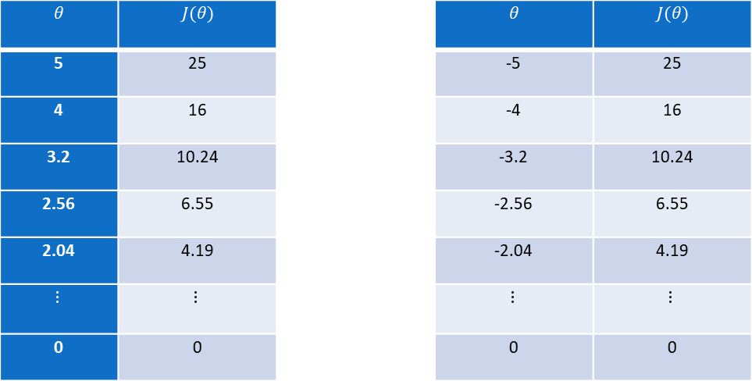

( F ) Table Generation:
Here we are stating with θ = 5.keep in mind that here θ = 0.8*θ, for our learning rate and cost function.
We can see that, as we increase our number of iterations, our cost value goes down and the algorithm converges to the optimum value $0$
$$θ$$ | $$J(θ)$$ |  | $$θ$$ | $$J(θ)$$
5 | 25 |  | -5 | 25
4 | 16 |  | -4 | 16
3.2 | 10.24 |  | -3.2 | 10.24
2.56 | 6.55 |  | -2.56 | 6.55
2.04 | 4.19 |  | -2.04 | 4.19
$$⋮$$ | $$⋮$$ |  | $$⋮$$ | $$⋮$$
0 | 0 |  | 0 | 0

Slide 36
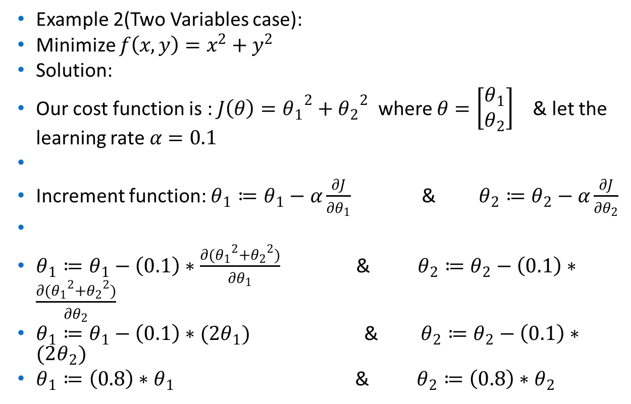
Example:Two variable case
Example 2(Two Variables case):
Minimize $f\left(x,y\right)=x^{2}+y^{2}$
Solution:
Our cost function is : $J\left(θ\right)={θ_{1}}^{2}+{θ_{2}}^{2}$ where $θ=\left[\begin{matrix}θ_{1} \\ θ_{2}\end{matrix}\right]$ & let the learning rate $α=0.1$
Increment function: $θ_{1}≔θ_{1}−α\frac{∂J}{∂θ_{1}}$ & $θ_{2}≔θ_{2}−α\frac{∂J}{∂θ_{2}}$
$θ_{1}≔θ_{1}−\left(0.1\right)∗\frac{∂({θ_{1}}^{2}+{θ_{2}}^{2})}{∂θ_{1}}$ & $θ_{2}≔θ_{2}−\left(0.1\right)∗\frac{∂({θ_{1}}^{2}+{θ_{2}}^{2})}{∂θ_{2}}$
$θ_{1}≔θ_{1}−\left(0.1\right)∗(2θ_{1})$ & $θ_{2}≔θ_{2}−\left(0.1\right)∗(2θ_{2})$
$θ_{1}≔\left(0.8\right)∗θ_{1}$ & $θ_{2}≔\left(0.8\right)∗θ_{2}$

Slide 37
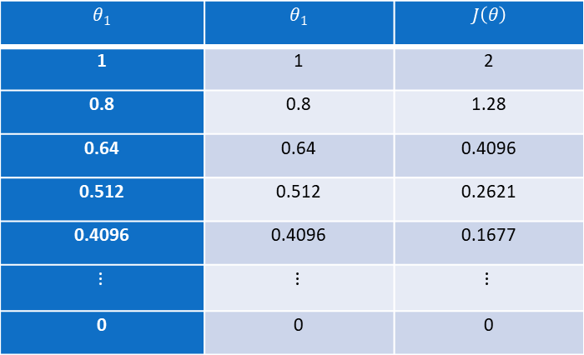

Initialize $θ_{1}=1 \& θ_{2}=1$ and iterate
We can see that, as we increase our number of iterations, our cost value goes down and the algorithm slowly converges to the optimum value $(0,0)$
$$θ_{1}$$ | $$θ_{1}$$ | $$J\left(θ\right)$$
1 | 1 | 2
0.8 | 0.8 | 1.28
0.64 | 0.64 | 0.4096
0.512 | 0.512 | 0.2621
0.4096 | 0.4096 | 0.1677
$$⋮$$ | $$⋮$$ | $$⋮$$
0 | 0 | 0

